Slide 1
Crafting & compelling website analysis, audit and recommendation
Swetha.m

Slide 2

HCL TECH (Hindustan computers limited)

Slide 3
INTRODUCTION OF THE COMPANY
Started in the year 1976 at Noida, Uttra Pradesh in India
Founder: Shiv Nadar.
First India IT servicesn (hardwaew company)
Before the HCL technologies India had only 250 computers
In 1978, HCL developed the first indigenous micro-computer at the same time as apple
Presence in 35 countries
Shiva Nadar initially invested 20 laks for starting HINDUSTAN COMPUTER LIMITED.

Slide 4
CONTENT
COMPANY DESCRIPTION
PRODUCT DESCRIPTION
WEBSTIE PLATFORM IDENTIFICATION
RESPONSIVE DESING TESTING
WEBSTIE MISTAKES IDENTIFICATION
BEST PRACTICES LIST
WEBSTIE DESIGN

Slide 5
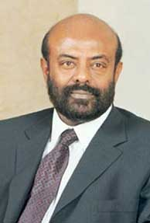
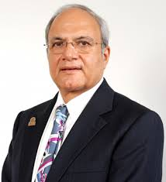

COMPANY DESCRIPTION
HCL Ltd is one of the pioneers in Indian IT market, with its origins in 1976.
HCL have been in the forefront in introducing new technologies and solution.
HCL Infosystem (HCL) Draws it’s strength from 29 years of experience in handling the ever changing IT scenario strong customer relationship.
Shiv Nadar
Chairman & CEO
Ajai chowdhry

Slide 6
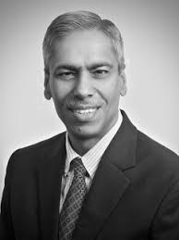
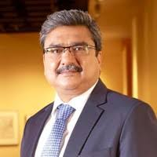
BOARD OF DEROCTERS
Anil Chanana
Chief Financial Officer (CFO)
Shiv Nadar
Found & CEO
Anant Gupta
President & CEO

Slide 7
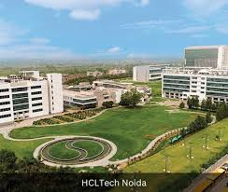
HCL Tech noida

Slide 8
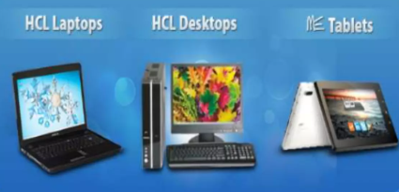
PRODUCT DESCRIPTION
Personal computer
Laptop
Printer
Mobile
Sanner
Medical equipment’s……etc.

Slide 9
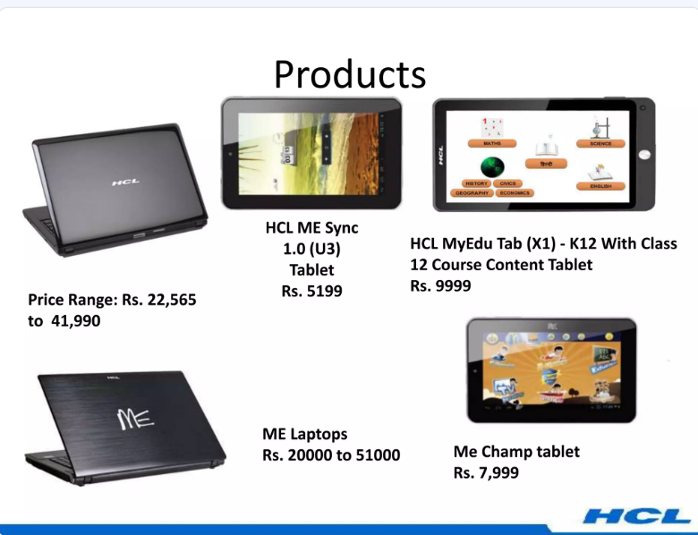

Slide 10
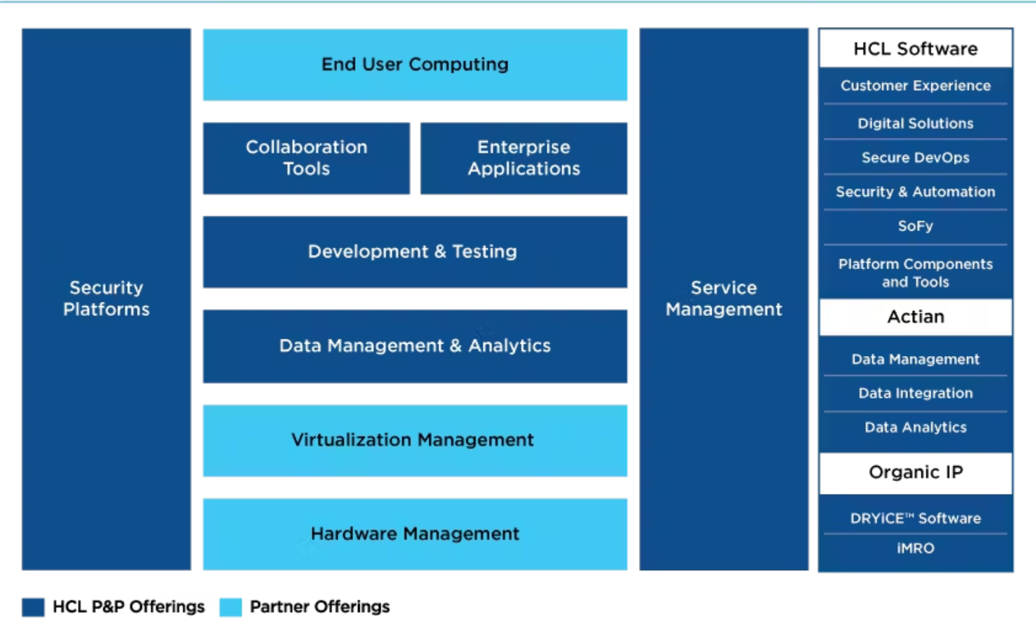
Software product

Slide 11
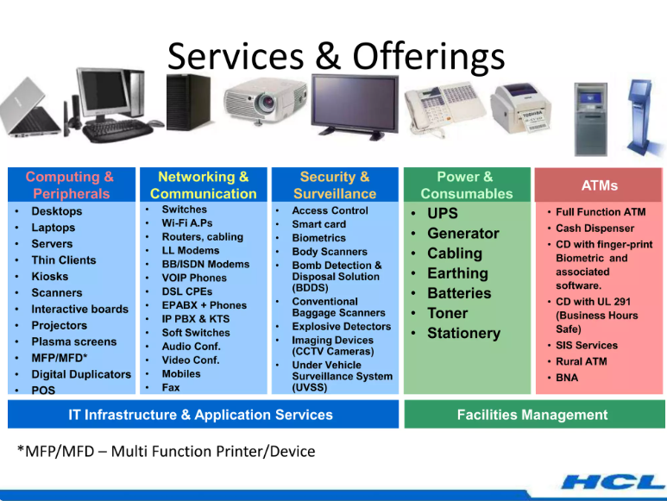
SERVICRS

Slide 12

Website platform identification

Slide 13
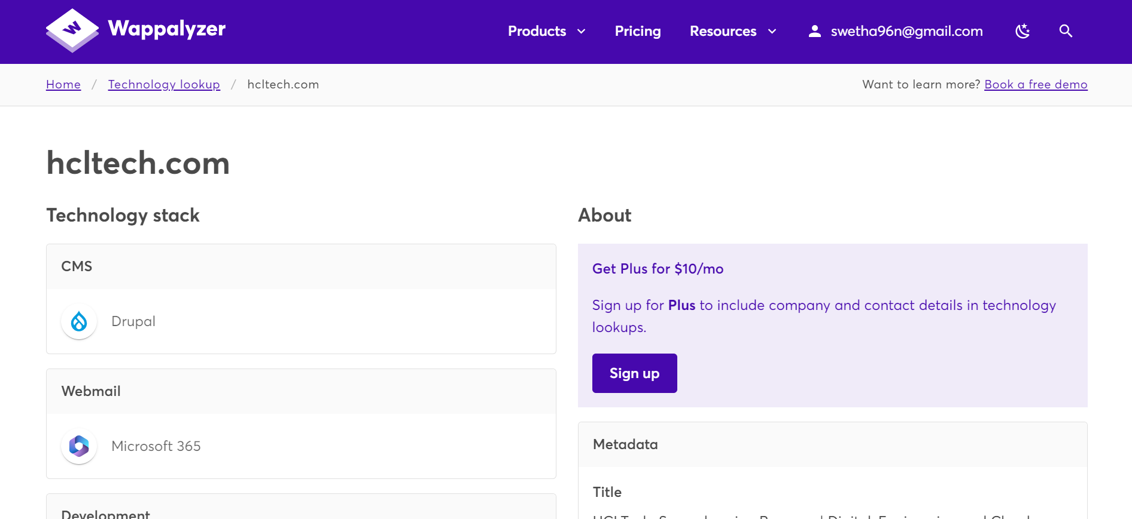

Slide 14
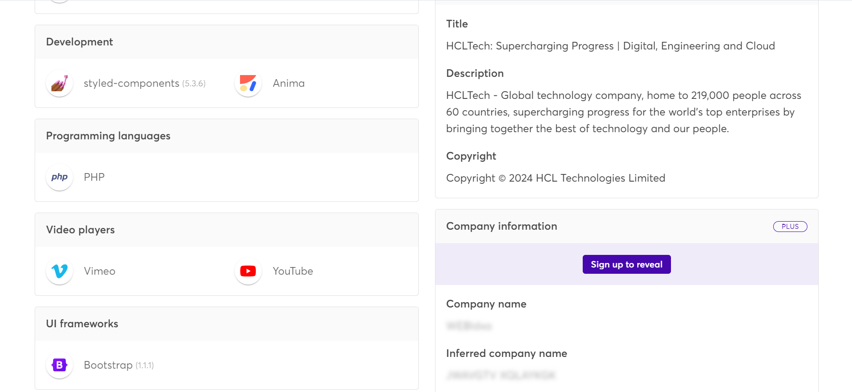

Slide 15
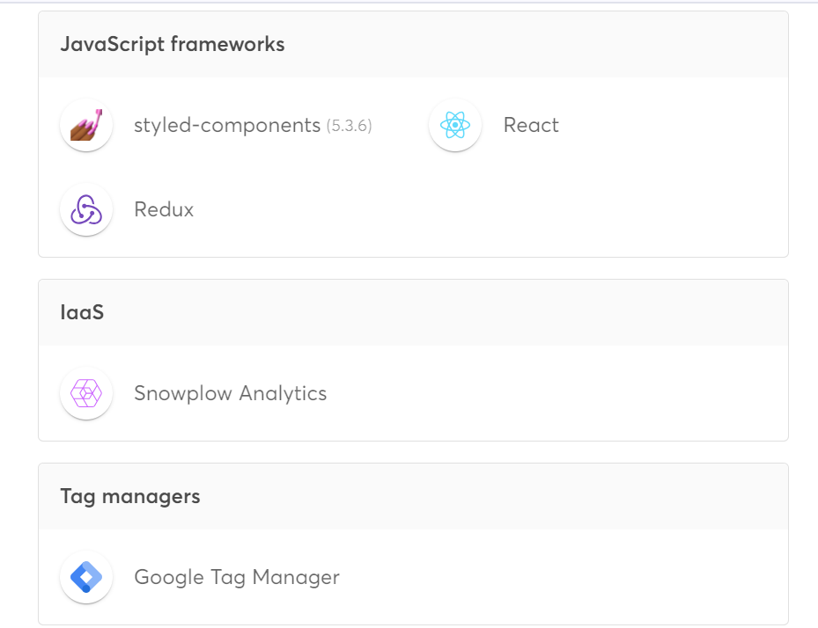

Slide 16
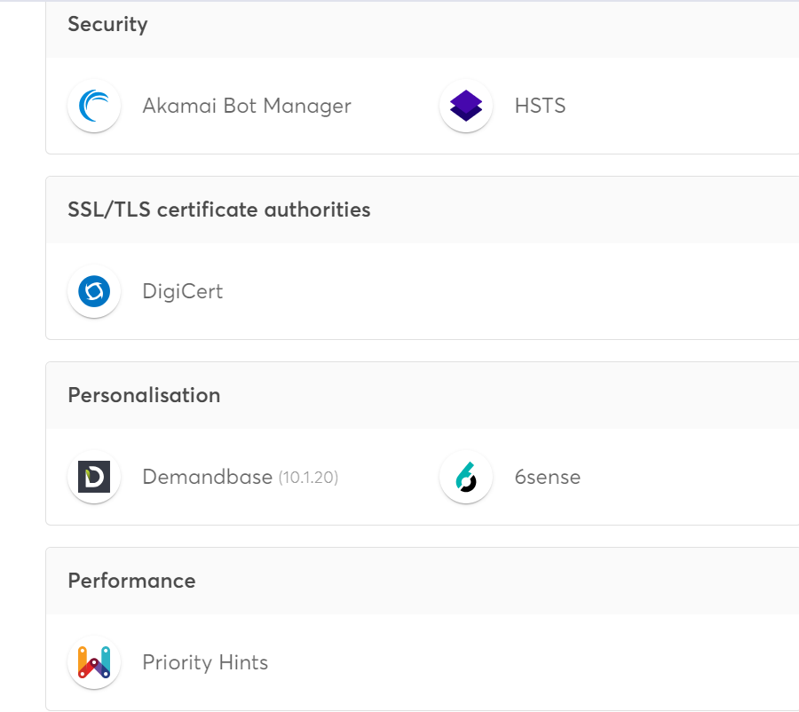

Slide 17
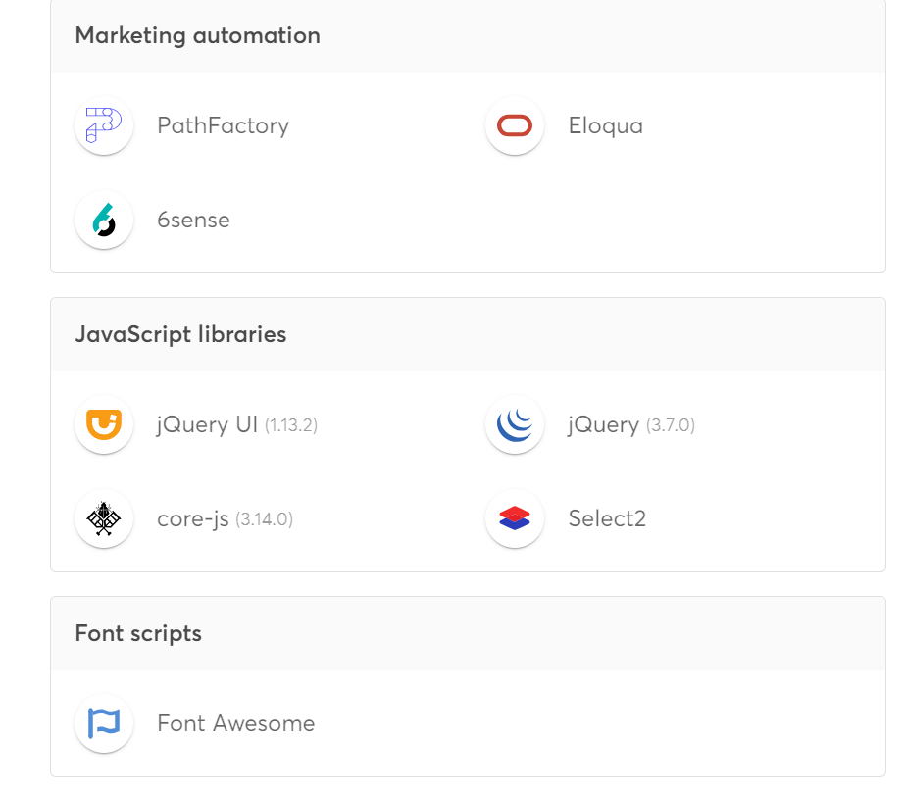

Slide 18
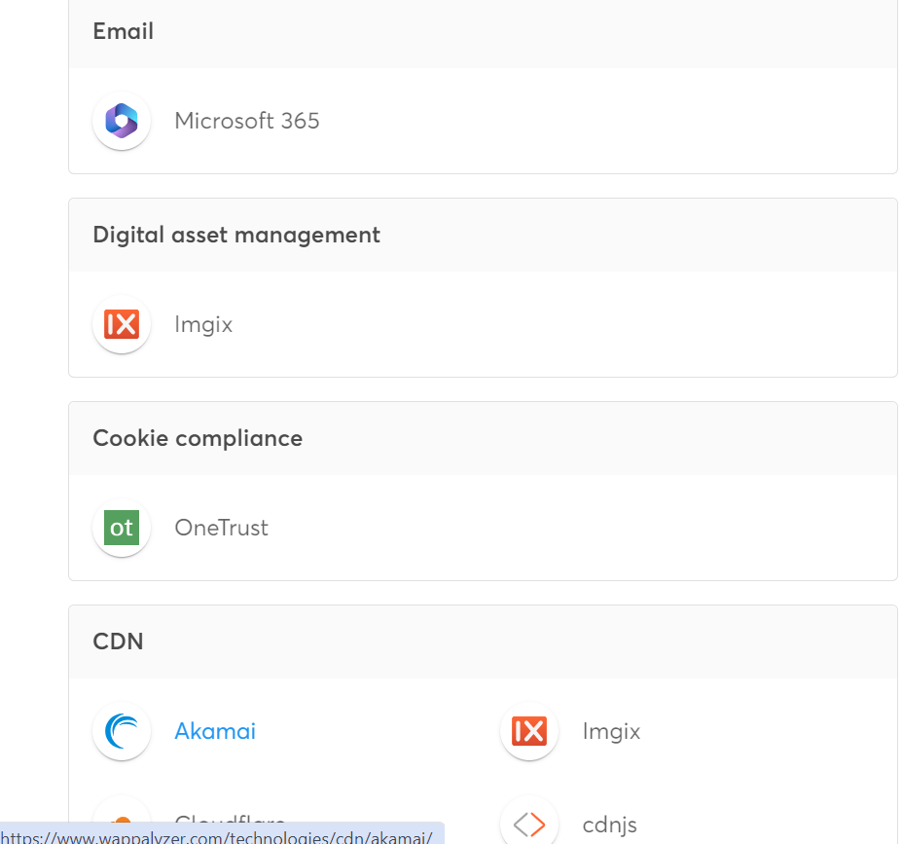

Slide 19
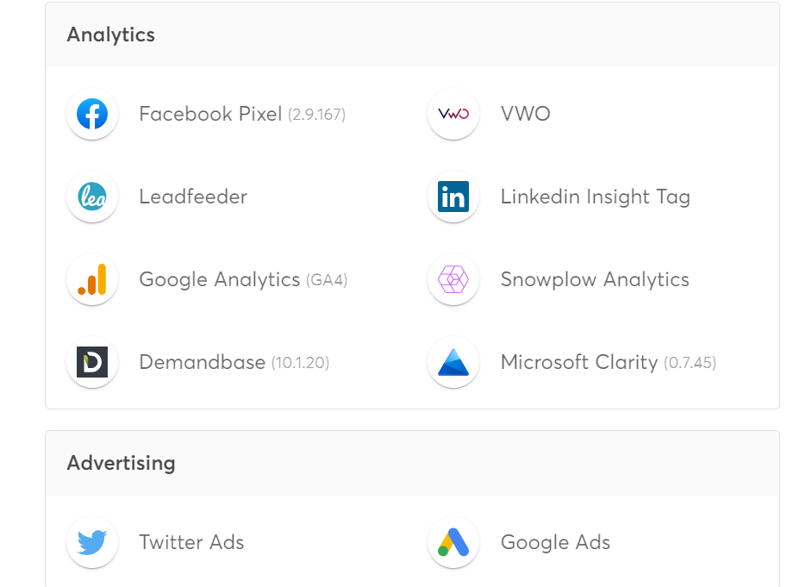

Slide 20
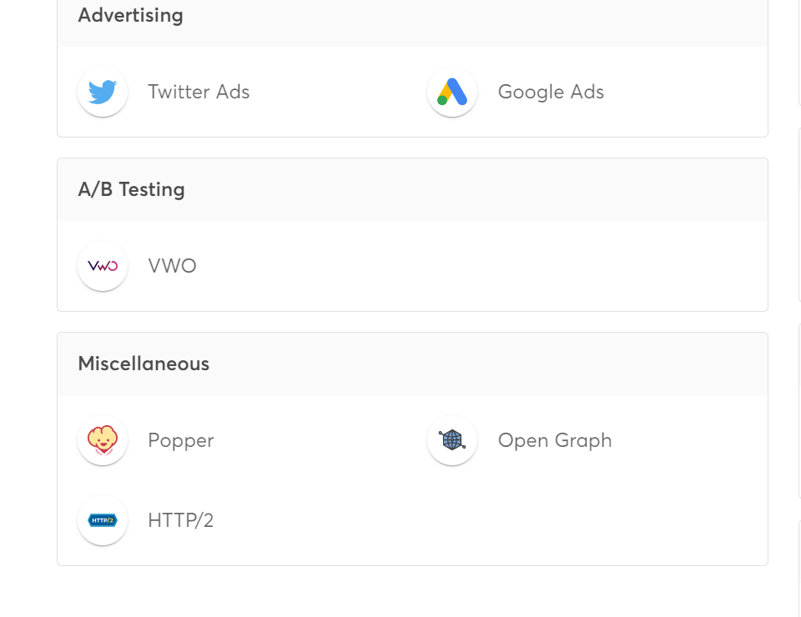

Slide 21
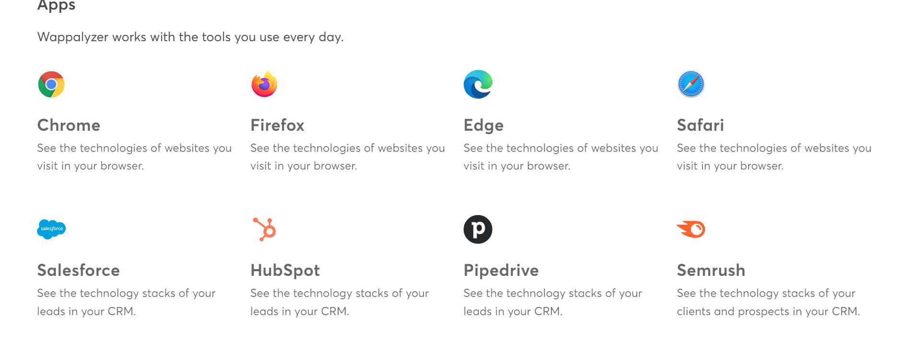

Slide 22
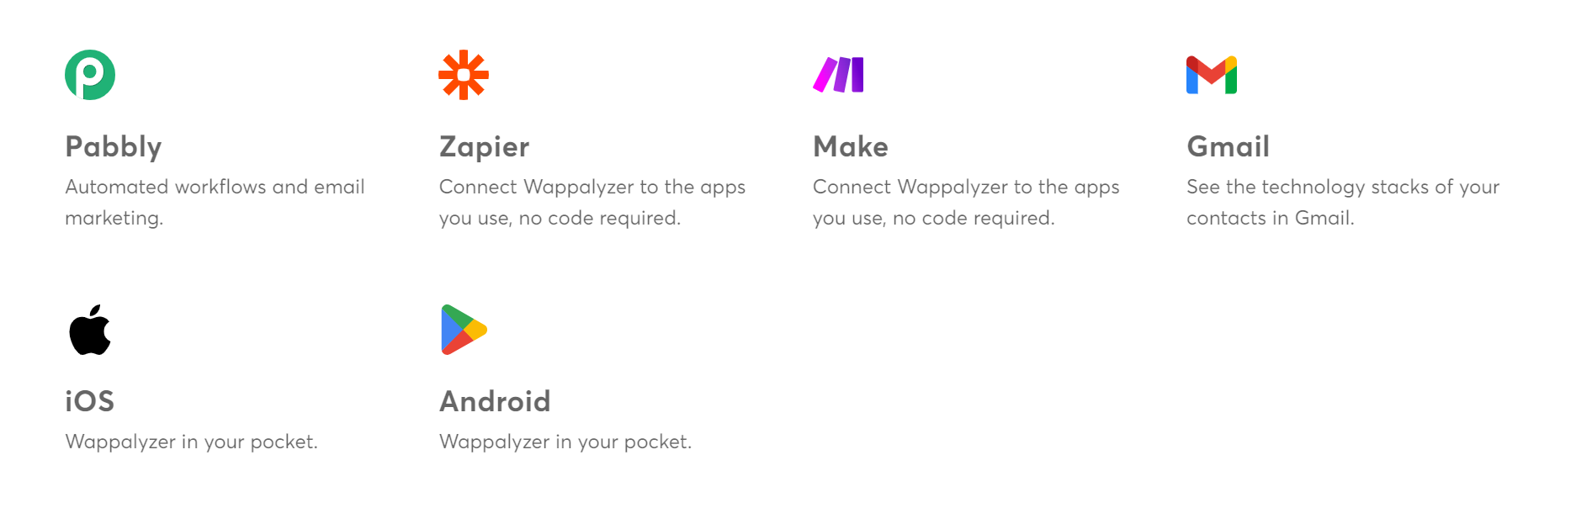

Slide 23
Responsive design testing
https://www.hcltech.com/ai - https://pagespeed.web.dev/analysis/https-www-hcltech-com-ai/o835lze98k?form_factor=mobi
https://www.hcltech.com/cloud-services - https://pagespeed.web.dev/analysis/https-www-hcltech-com-cloud-services/bzdzkv7kzx?form_factor=mobile
https://www.hcl-software.com/ - https://pagespeed.web.dev/analysis/https-www-hcl-software-com/84s6riolbl?form_factor=mobile
https://www.hcltech.com/financial-services - https://pagespeed.web.dev/analysis/https-www-hcltech-com-financial-services/tphkylfiiy?form_factor=mobile
https://www.hcltech.com/careers - https://pagespeed.web.dev/analysis/https-www-hcltech-com-careers/alnjpx2cmz?form_factor=mobile

Slide 24
Website mistake identification
Low pay
Some say that HCL pays less than the industry standard and that there are few salary hikes
Poor management
Some say that management is poor and that managers ignore employees on the bench
Micromanagement
Some say that employees are micromanaged, even for things that aren't important to their job

Slide 25
Lack of growth
Some say that there is no opportunity for growth and that it's hard to move to a better project
Delayed bonuses and raises
Some say that bonuses and raises are delayed

Slide 26
Best practices list
Fast loading
Optimizinf website for fast loading, it helps to keep engaging uses.
Easy accessibility
Designing wesite to be accessible to all users.
Mobile responsive
Websie should be fully responsive and displays well on all devices, from desktops to smartphones.

Slide 27
Animation:
Use animation sparingly and strategically to add interest and improve user engagememt.
User test:
Conduct user testing to gathr feedback and identify areas for improvement.

Slide 28
Click Here

Slide 29
T H A N K Y O U

